Slide 1

Public Health Surveillance & Outbreak Tracking
The Goal: Shifting from reactive to proactive healthcare. By analyzing daily admission records, we can identify "spikes" in specific symptoms before they become full-blown epidemics.
KPK Context: Focusing on seasonal endemic patterns like Dengue during the monsoon or Malaria in warmer months.
Spatial Tracking: Identifying clusters in specific union councils or districts to target vaccination and fumigation efforts effectively.

Slide 2

Medical Imaging Pipelines (The DICOM Standard)
What is DICOM?: Digital Imaging and Communications in Medicine. It is the universal format for MRI, CT, and X-ray data.
The Architecture: A DICOM file is more than an image; it contains a "header" with patient metadata (protected by privacy protocols) and a "pixel array" containing high-depth anatomical data.
Processing: Using Python to extract specific "slices," normalize pixel intensities, and prepare the data for advanced segmentation models.

Slide 3
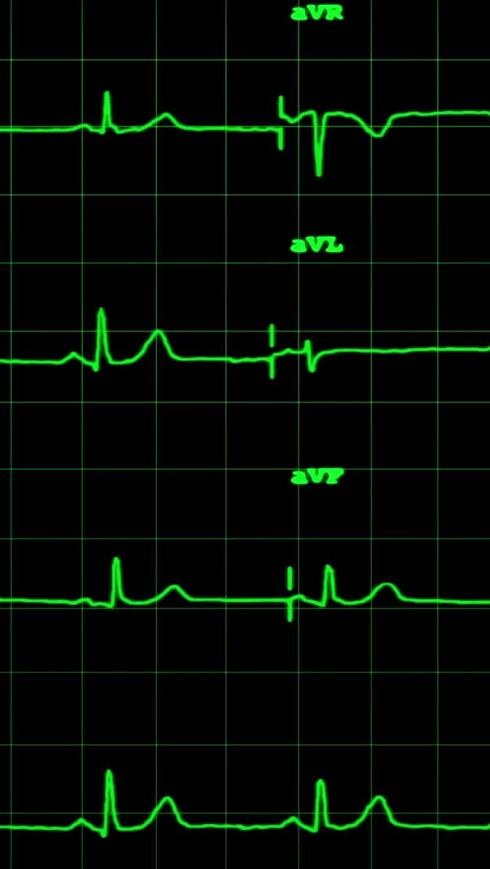
Patient Flow & Hospital Optimization
The Bottleneck Problem: Large centers like Lady Reading Hospital (LRH) handle thousands of patients daily. Bottlenecks in triage or diagnostic testing can lead to dangerous delays.
Queueing Theory: Using data to model patient arrival rates (lambda) and service rates (mu) to calculate the optimal number of staff required at any given hour
.Outcome: Reducing the "Wait-to-Treatment" ratio to improve patient satisfaction and clinical outcomes.

